Slide 1

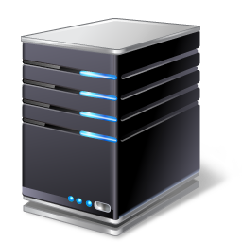
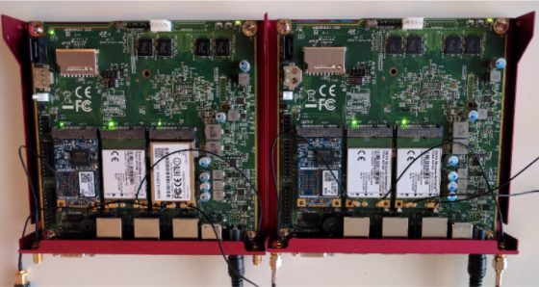
downlink
MONROE node
Telenor
Amazon VM
Internet
ASTREAM Client
ASTREAM Server
Telia
uplink
ICE

Slide 2

MONROE node
Telenor
Amazon VM
Internet
ASTREAM Client
ASTREAM Server
Telia
ICE

Slide 3

MONROE node
Telenor
Amazon VM
Internet
ASTREAM Client
ASTREAM Server
Telia
ICE

Slide 4
MONROE node
Telenor
Amazon VM
Internet
ASTREAM Client
ASTREAM Server
Telia
Basic SARA BBA
ICE

Slide 5
MONROE node
Telenor
Amazon VM
Internet
ASTREAM Client
Telia
ASTREAM Server
Basic SARA BBA
ICE

Slide 6
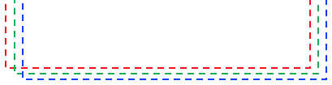
MONROE node
Amazon VM
Telenor
Internet
ASTREAM Client
Telia
ASTREAM Server
ICE
Basic SARA BBA

Slide 10
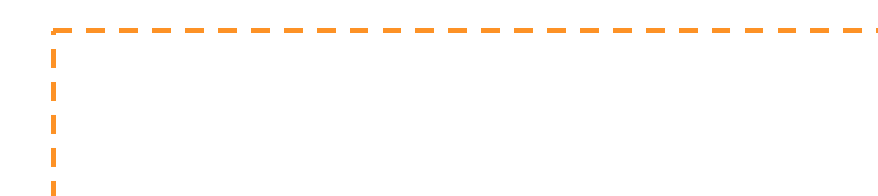
Google
YouTube
YouTube Client
YouTube Server
Internet
MONROE node
ASTREAM Client
Simula
Vodafone
Basic SARA BBA
ASTREAM Server

Slide 11
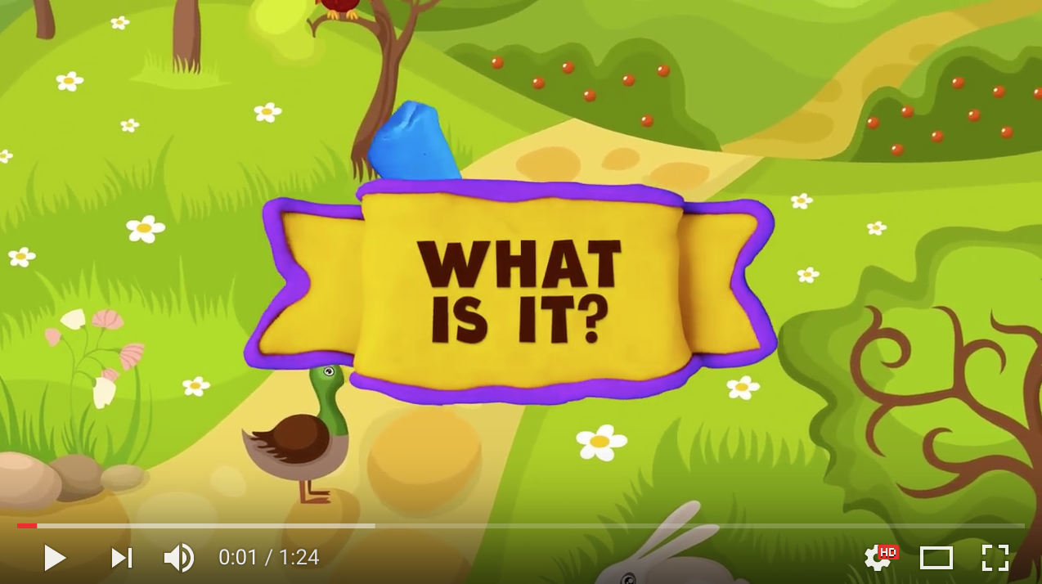
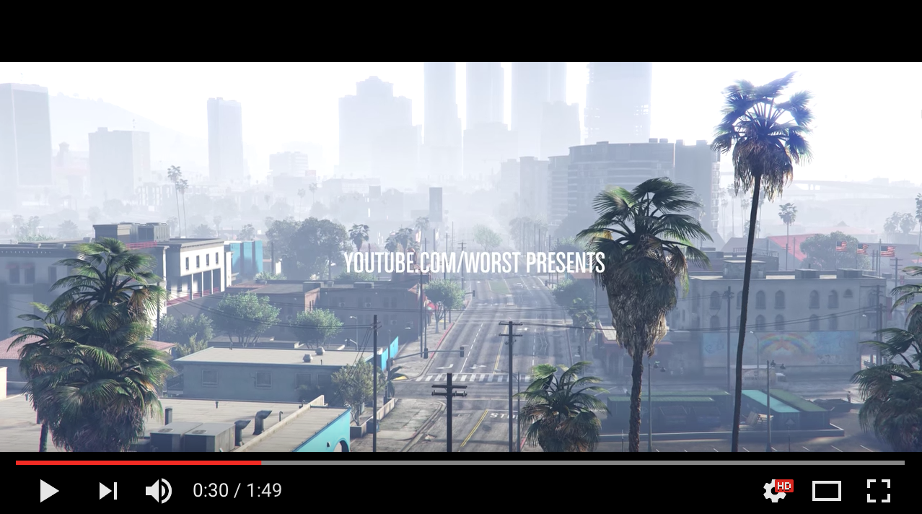
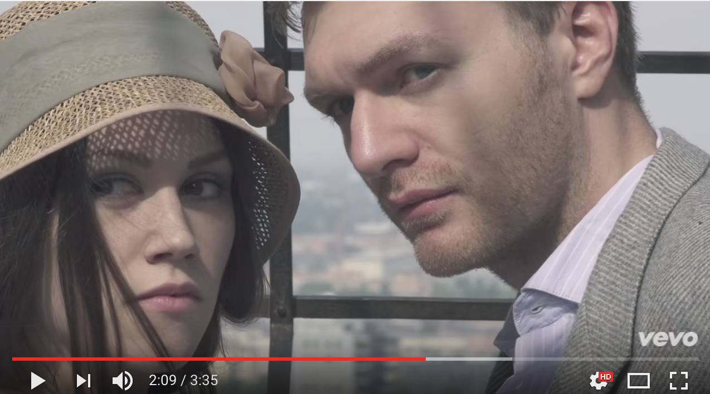

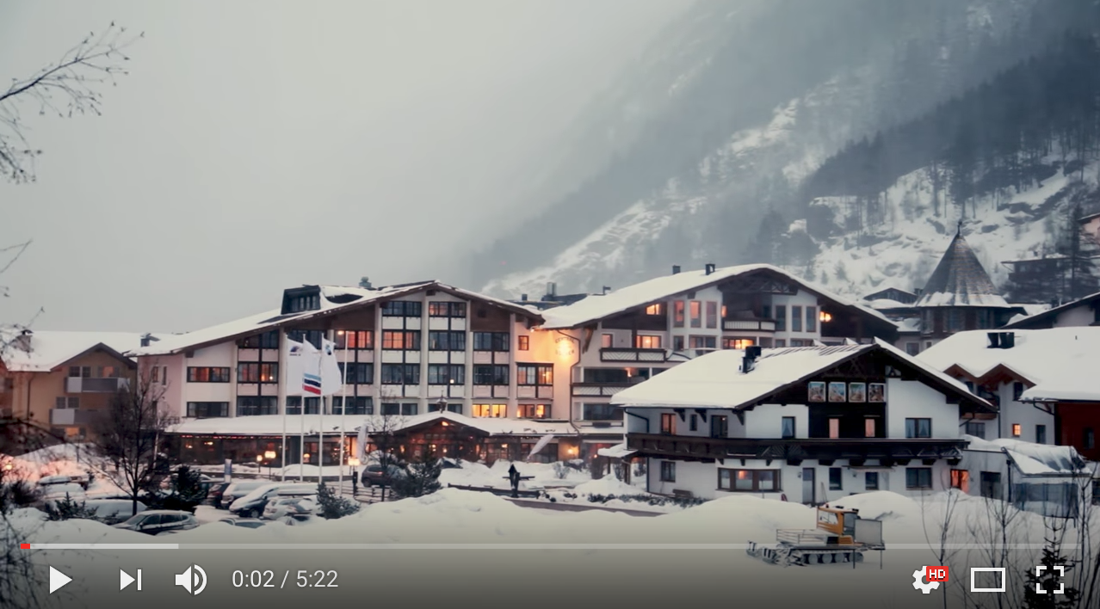
1. Download available representations
2. Generate MPD and segments
3. Load MPD and segments to server
4. Specify desired MPD in runtime (Docker config)
MONROE node

